Slide 2
Successful campaigns are:
32 days long

Slide 3
No matter the main category
BUT
MUSIC and THEATER are more successful than not, no matter the campaign length

Slide 4
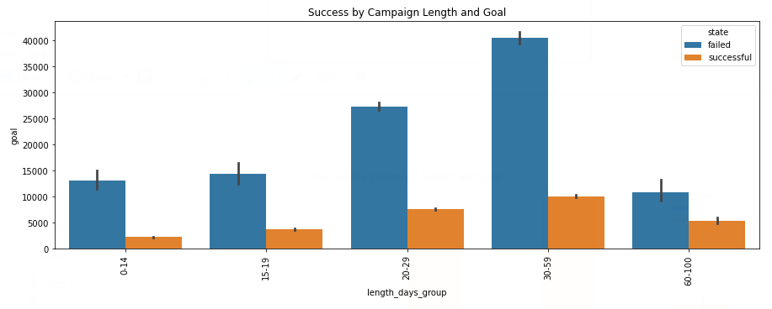
Successful Projects 20-59 days long
May have lower goals than failed projects of the same length, but

Slide 5
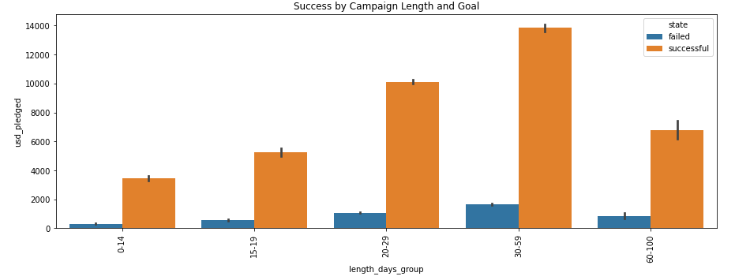
Successful Projects 20-59 days long
When they succeed, they bring in the most money

Slide 6
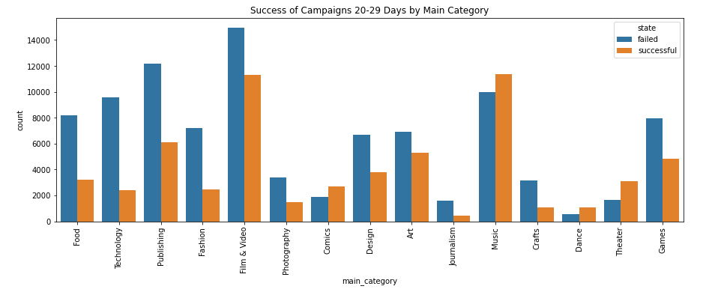
Successful Projects 20-59 days long
Music, theater, comics, dance

Slide 7
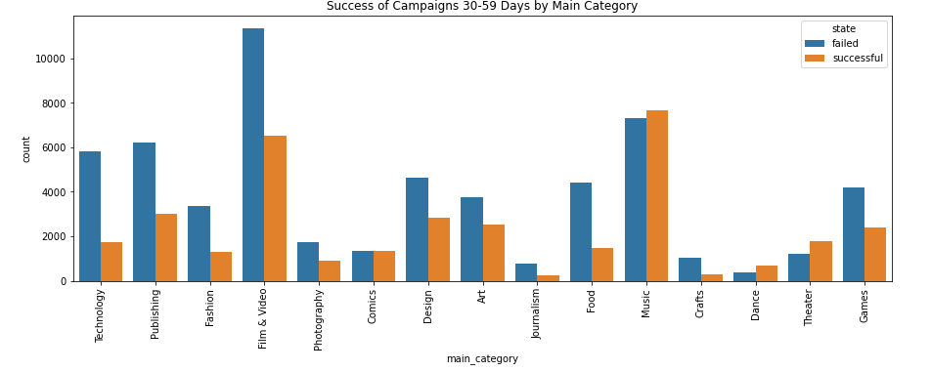
projects 20-59 days long
Music, theater, comics, dance have best chance of success at this length

Slide 8
20-59 days
Music
theater
comics
dance
Median goal: $3,500
Median goal: $2,800
Median goal: $3,000
Mean goal: $5,315
Median goal: $3,000
Mean goal: $4,763

Slide 9
Successful Projects with Goals of $0 - $1,999 (52% success rate)
optimal backers for success: 0-59
optimal length for success: 15-29 days

Slide 10
Successful Projects with Goals of $2,000 - $4,999 (45% success rate)
optimal backers for success: 20-99
optimal length for success: 15-59 days

Slide 11
Successful Projects with Goals of $5,000 - $14,999 (38% success rate)
optimal backers for success: 60-150
optimal length for success: 15-59

Slide 12
Successful Projects with Goals of $15,000 - $29,999 (28% success rate)
optimal backers for success: 60-150
optimal length for success: 15-59

Slide 13
Successful Projects with Goals of $30,000+ (14% success rate)
optimal backers for success: 100+
optimal length for success: 15-59 days

Slide 14
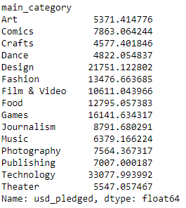
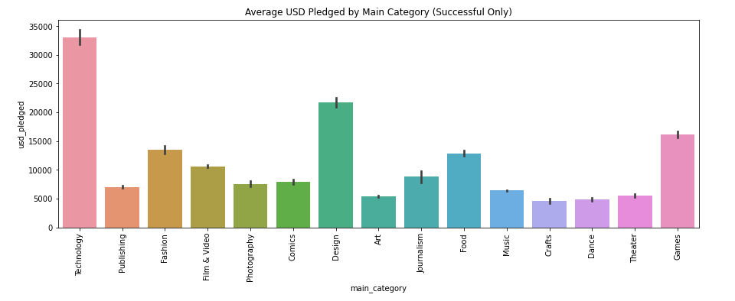
Tech, design, games
Bring in the most money for successful projects

Slide 15
Failed projects that near completion
199/129,720 = 0.15% of failed projects ALMOST meet goal (90-99% funded)
average goal of these projects is $14,049
average length of these projects is 33 days
average backers of these projects is 102

